Slide 1
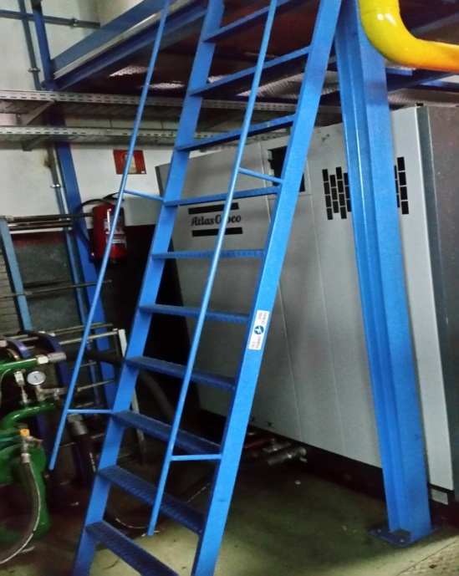

HS&E INCIDENT BULLETIN |  | 2nd half year 2016
Minano, Spain | Type of incident (Shoulder Fracture – Fall from Height)
Summary:
While accessing the top of a platform using the appropriate fixed maintenance ladder, the employee slipped. In order to recover his balance, he made an abrupt effort to secure himself with his left arm on the handrail he was using. As a result of this body stress, he felt a pain in his shoulder. After a first medical evaluation that diagnosed an inflammation treated by rest and basic pain medication, a second evaluation was necessary. Physiotherapy was prescribed to help him recover.
Root Causes: | Actions Taken Thus Far: Next Steps
Ladder: Footprint of ladder rungs is not large enough to comply with requirements. Ladder angle is close to 90°due to lack of available space on the floor. Visibility of rungs: The edges of the rungs are not highlighted or marked. Behavior : Possible lack of awareness while using the ladder. | Analyze the possibility of increasing the footprint of the ladder rungs. Analyze the possibility of installing stairs instead of a ladder to reduce the angle. Perform a Hazard Hunt to look for similar situations. Reinforce awareness of “slips, trips and falls” hazards.

